Slide 1
CloudBees Support

Slide 2
What is CloudBees Support
The Support plugin provides the ability to generate a bundle of all the commonly requested information used by CloudBees when resolving support issues

Slide 3
Benefits: CloudBees Support
Since some CloudBees customers purchase support contracts without being licensed for CloudBees Jenkins Enterprise, this plugin is also available for download and installation into any Jenkins installation. Simply go to the plugin’s release notes, pick the latest version, and click the link in the Download section (such as to http://jenkins-updates.cloudbees.com/download/plugins/cloudbees-support/*latest*/cloudbees-support.hpi). You can install the downloaded plugin using Manage Jenkins » Manage Plugins » Advanced » Upload Plugin

Slide 4
Where do we start?
To generate a bundle, simply go to the CloudBees Support link on the Jenkins instance.

Slide 5
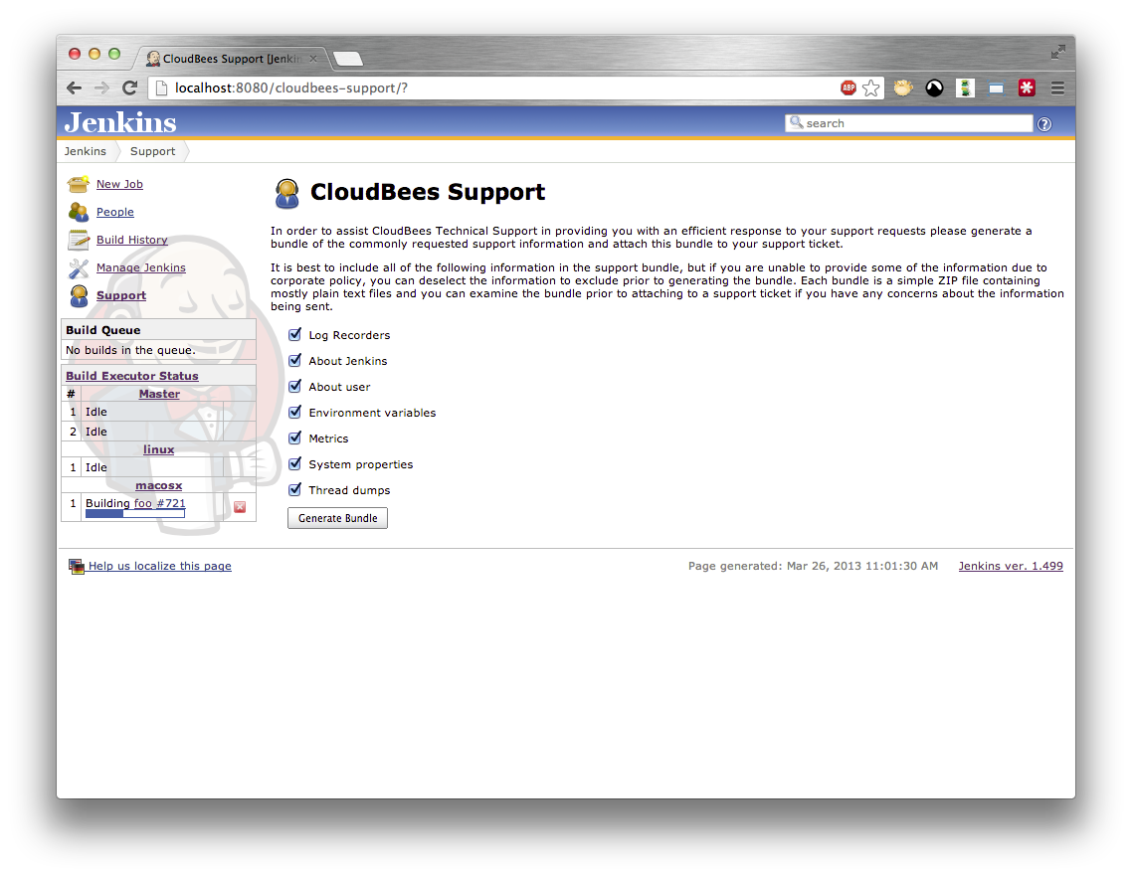
Where do we start?(Cont.)

Slide 6
Lab Exercise:
CloudBees Support

